Slide 1
BASIS DATA LANJUT
PL/SQL Control Structures
Oleh : (3122600003)Dukhaan Kamimpangan
Kelas : 2 D4 IT A

Slide 2
TUGAS
4
PL/SQL Control Structures

Slide 3
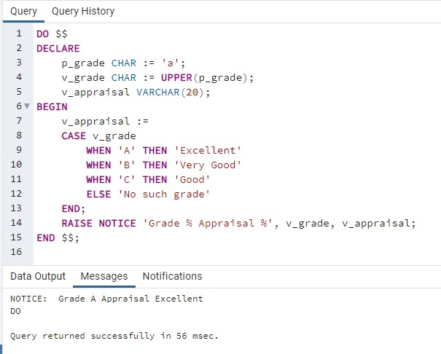
PART 1
Case Statement
DO $$
DECLARE
p_grade CHAR := 'a';
v_grade CHAR := UPPER(p_grade);
v_appraisal VARCHAR(20);
BEGIN
v_appraisal :=
CASE v_grade
WHEN 'A' THEN 'Excellent'
WHEN 'B' THEN 'Very Good'
WHEN 'C' THEN 'Good'
ELSE 'No such grade'
END;
RAISE NOTICE 'Grade % Appraisal %', v_grade, v_appraisal;
END $$;

Slide 4
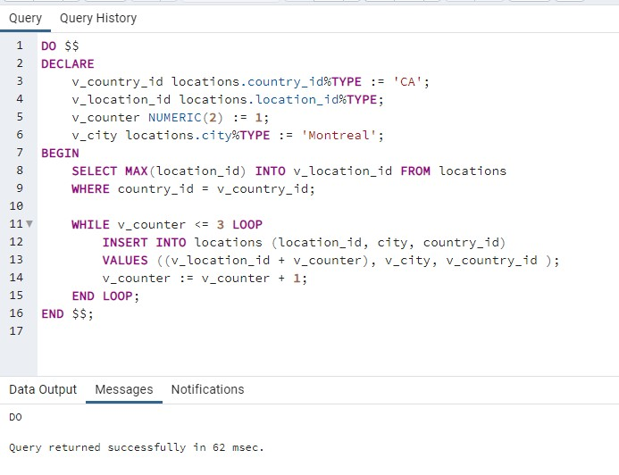
Basic Loop
DO $$
DECLARE
v_country_id locations.country_id%TYPE := 'CA';
v_location_id locations.location_id%TYPE;
v_counter NUMERIC(2) := 1;
v_city locations.city%TYPE := 'Montreal';
BEGIN
SELECT MAX(location_id) INTO v_location_id FROM locations
WHERE country_id = v_country_id;
WHILE v_counter <= 3 LOOP
INSERT INTO locations (location_id, city, country_id)
VALUES ((v_location_id + v_counter), v_city, v_country_id );
v_counter := v_counter + 1;
END LOOP;
END $$;

Slide 5
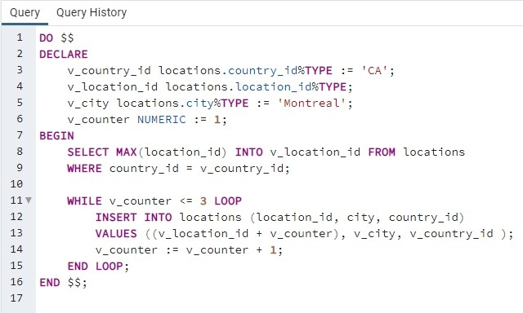
While Loop
DO $$
DECLARE
v_country_id locations.country_id%TYPE := 'CA';
v_location_id locations.location_id%TYPE;
v_city locations.city%TYPE := 'Montreal';
v_counter NUMERIC := 1;
BEGIN
SELECT MAX(location_id) INTO v_location_id FROM locations
WHERE country_id = v_country_id;
WHILE v_counter <= 3 LOOP
INSERT INTO locations (location_id, city, country_id)
VALUES ((v_location_id + v_counter), v_city, v_country_id );
v_counter := v_counter + 1;
END LOOP;
END $$;

Slide 6
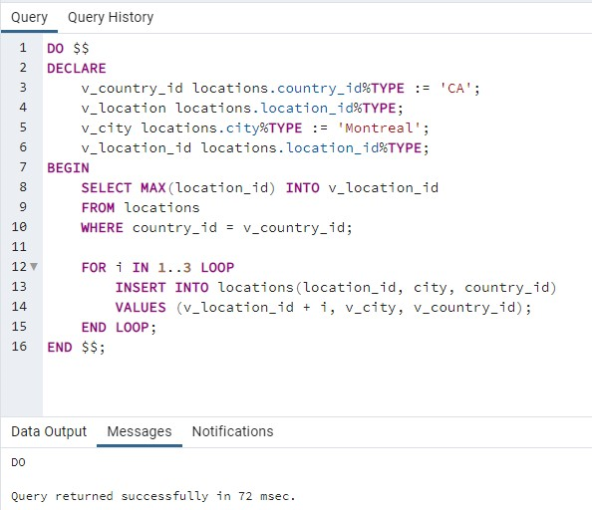
For Loop
DO $$
DECLARE
v_country_id locations.country_id%TYPE := 'CA';
v_location locations.location_id%TYPE;
v_city locations.city%TYPE := 'Montreal';
v_location_id locations.location_id%TYPE;
BEGIN
SELECT MAX(location_id) INTO v_location_id
FROM locations
WHERE country_id = v_country_id;
FOR i IN 1..3 LOOP
INSERT INTO locations(location_id, city, country_id)
VALUES (v_location_id + i, v_city, v_country_id);
END LOOP;
END $$;

Slide 7
TERIMA KASIH

